Slide 1
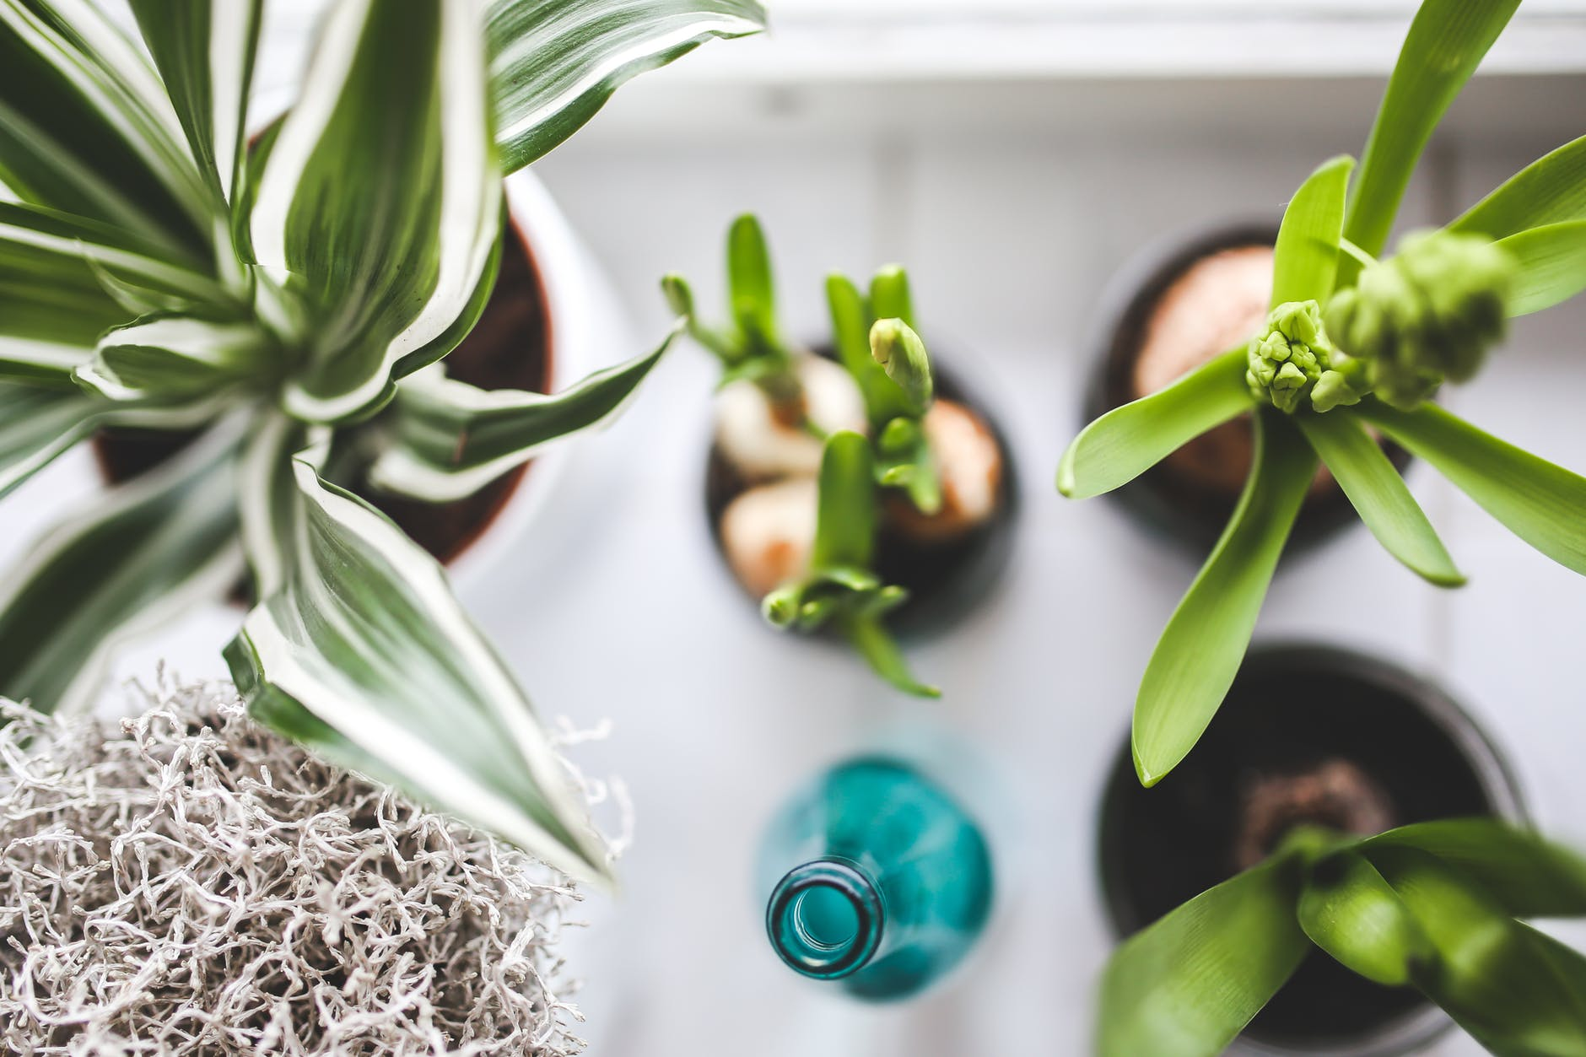
THE FUTURE OF
SMART GARDENING
STARTS HERE.

Slide 2

Smart Eco System Client Pitch
Prepared By TEAM DDNS
Dorota Marczak, Nader Sobhi, Declan Bell and Scott Allan
Abertay University
23.10.2018

Slide 3
Product Brief
The Client
Lynsey Shepard of Abertay Plant System to build
an IoT plant monitoring system
The Brief
Build an inexpensive alternative to current products
Collect data on the plants environment
Provide a graphical representation of the data collected

Slide 4
What Will Be Covered In The Talk?
-The client requirements and how we will meet them
- How we will build the Monitoring System
- How we approached the project
- Potential risks
- Benefits/costs

Slide 5
Client Requirements
Gather sensor data from plant : temperature, light, moisture, humidity
Collect data into Database
Present data in a graphical manner on website
Ability to produce device commercially
Easy set-up of device

Slide 6
Meeting Client Requirements
In order to meet the client requirements, the following will be done:
Use an Arduino UNO paired with a WEMOS board
to collect data from sensors
Push the data collected from the hardware to a database
Create a web portal that dynamically graphs data
Devices will be very easy to manufacture on a large scale
Device will be easy to setup

Slide 7
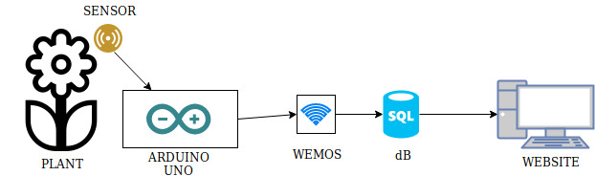
The Build
Plant:
TBD
Sensor:
Light, Temperature, Moisture, Humidity
Arduino Uno:
Collects information from sensors
WEMOS:
Provides internet connectivity & data routing
Database:
Holds collected data
Website:
Displays collected information

Slide 8
Project Approach
In order to complete this project the following is required:
Created project plan
Test feasibility of desired outcome
Regular consultations with client – improvements or concerns
Produce necessary project documentation
Develop prototype – hardware and performance testing
Share notice board with the client

Slide 9

Methodology
Agile
Communication and collaboration
Functioning software
Team self organization
Adaptable
Scrum
Values real-world results
Break down work into Sprints,
continuous improvement
Test Driven Development
Refine product based on test results

Slide 10
Deliverables
Executive Summary
Cost breakdown
A prototype will be showcased to the client throughout development
Results from performance testing
User manual and other required documentation
Final product will contain a hardware device, website and database

Slide 11
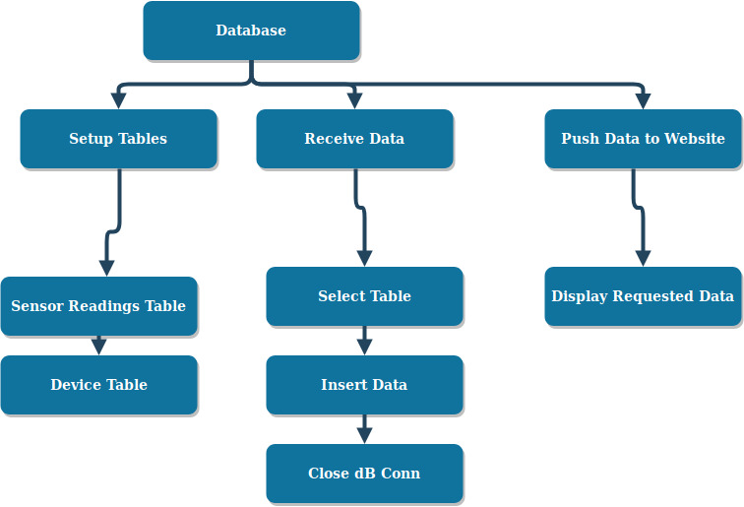
Work Breakdown Structure: Database

Slide 12
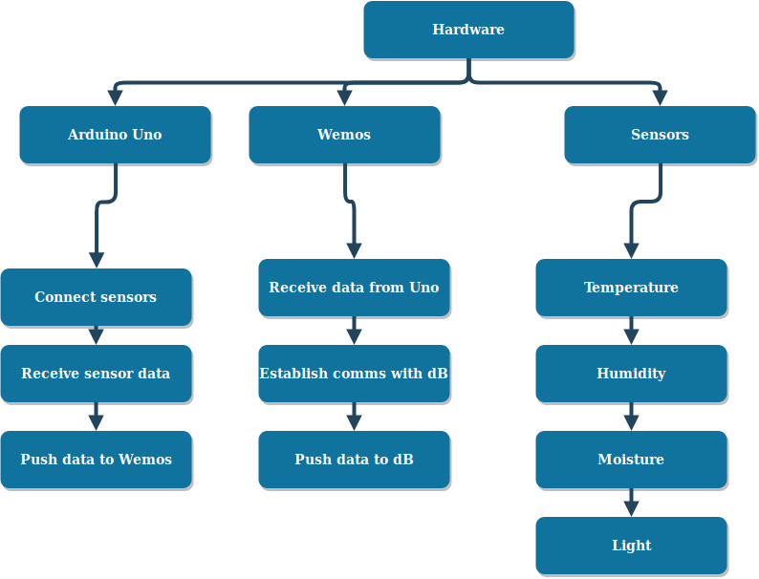
Work Breakdown Structure: Hardware

Slide 13
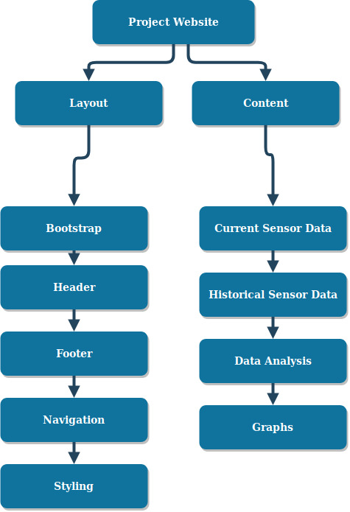
Work Breakdown Structure: Website

Slide 14
Risks
Exceed predetermined budget
- Use only resources needed
Inconsistent staff availability
- Overlap responsibilities
Technology in use becoming obsolete
- Research current/upcoming developments
Data Protection Regulation changing
- Keep up with current legislation and any upcoming developments
Competitor creating alternative solution
- Ensure we have lowest cost/most versatile product
Delay in delivering final product
- Ensure work schedule is managable and project goal is achievable

Slide 15
Benefits
A reputation for fine IoT device production
Low cost of production
Easy to produce & advertise
Low maintenance costs
Be part of the Open Source Community

Slide 16
Costs
The hardware needed
The maintenance of the production line
The database and web hosting
Potential commercial licences

Slide 17
Going Forward
Ensure continued communication with the client
Better inter-team communication
Comprehensive description of working processes
Better software development methodologies

Slide 18
Thanks For Listening
We will now field any questions...

